Slide 1
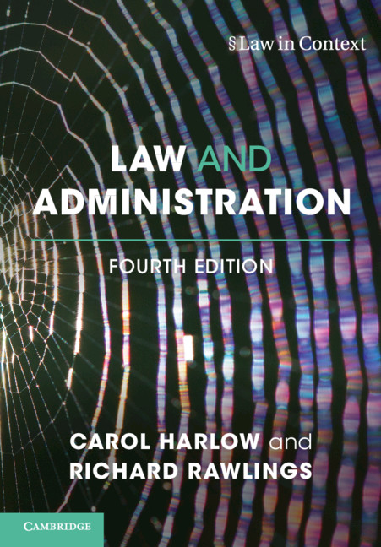
[Core Text]: [COURSE NUMBER]: [COURSE NAME]
Law and Administration
4th Edition
By Carol Harlow, London School of Economics and Political Science
Richard Rawlings, University College London
Available from [College Bookstore] or www.cambridge.org/highereducation/isbn/9781316604373

Slide 2
What is covered by the text?
Law and Administration takes a contextual approach to administrative law, setting law and legal rules in the context of the social, political and economic forces that shape the law, and of the complex constitutional framework in which contemporary administrative law operates. This book contains a full account of judicial review, the traditional heartland of administrative law, and adds to this by taking into account the concerns of government, officials and agencies who operate and shape the law. It also looks at the possible future of administrative law in an increasingly automated and digitalised world. A fully revised and updated new edition, this book includes new case studies of regulatory agencies and government contracting to develop understanding of law in practice.

Slide 3
Features
Students' full understanding encouraged with discussion of the law and its socio-political context
New pedagogy includes student-focused questions, and introductions and conclusions to every chapter
Completely updated to track the changing context of public administration and administrative law and reflect radical changes in the field.

Slide 4
What is the Cambridge Spiral eReader?
The eReader app allows students to download the textbooks that they can access via their institution to their own offline reading bookshelf.
The eReader app allows students to highlight, bookmark and make notes within the online version of the textbook.
For students with institutional access, they will be able to read the book via their institutional login, but will need a Cambridge Higher Education account to access the full functionality
Our eTextbooks are also available for purchase by individuals who would like perpetual access

Slide 5
Accessing the Textbook Online
You will be able to access the textbook online via your institutional login or personal account.
In order to access the full functionality of Cambridge Spiral eReader, you will also need to create a Cambridge University Press Higher Education account.
To access the textbook for offline reading, please download the Cambridge Spiral eReader app.
For more access FAQs, please read here
When signing up for a HE account, you will not be automatically opted into any marketing or sales from Cambridge University Press, unless you change your preferences. Our privacy notice can be found here: www.cambridge.org/about-us/legal-notices/privacy-notice

Slide 6
What Systems does the app work on?
Download Cambridge Spiral for Higher Education from Cambridge University Press Offline Windows App
System Requirements: Windows 7+
Click here to download
Download Cambridge Spiral for Higher Education from Cambridge University Press Offline Desktop App (Apple Mac)
System Requirements: Mac OS 10.12 Sierra and above.
Click here to download
Download Cambridge Spiral for Higher Education from Cambridge University Press iOS App (iPhone/iPad)
System Requirements: iOS 10.0 and above. Download the app from the Apple Store
Cambridge Spiral for Higher Education from Cambridge University Press Android App
System Requirements: Android version 8.0 and above. Download the app from Google Play

