Slide 1
Setting yourself up for TA Success
TA Support Workshop
2024
Gifty Abraham
Senior Training Executive

Slide 2
Before we begin…
This session is being recorded
Have questions? No problem!
We’ve scheduled in time for your questions!
Please complete the exit survey

Slide 3
3 Quick ways to set your TA up for success
1. Complete your RightsLink set up
2. Promote your TA and raise awareness
3. Use your TA with confidence: Answers at the ready

Slide 4
Step 1. Complete your RightsLink set up in less than 10 minutes
Ensure all contacts are added
Turn on automatic approvals
Set notifications
Reporting options

Slide 5
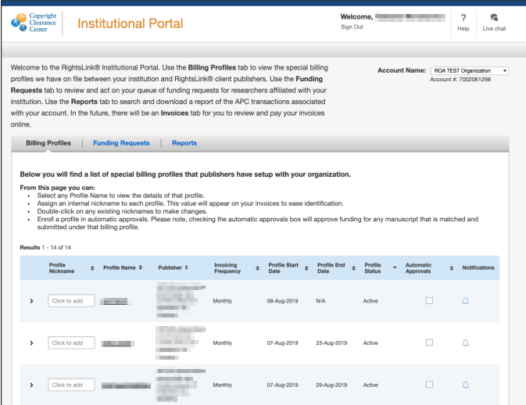
RightsLink is your OA agreement manager tool
We’ll run the eligibility checks for you - meaning a ‘touch free’ journey for the author and the TA administrator.
Institutions may also review and authorise APC funding requests.

Slide 6
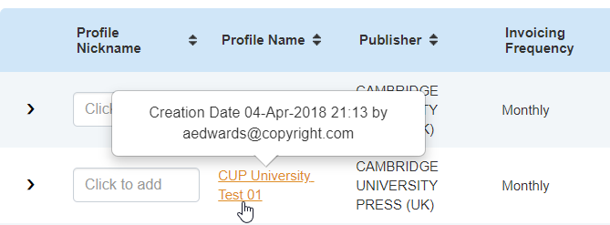
Ensure all contacts are added
To see details held on your billing profile click the Profile Name link.
You can edit your contact information within this space.
If you wish to change the email address that you use to log in to Agreement Manager, please get in touch with us.

Slide 7
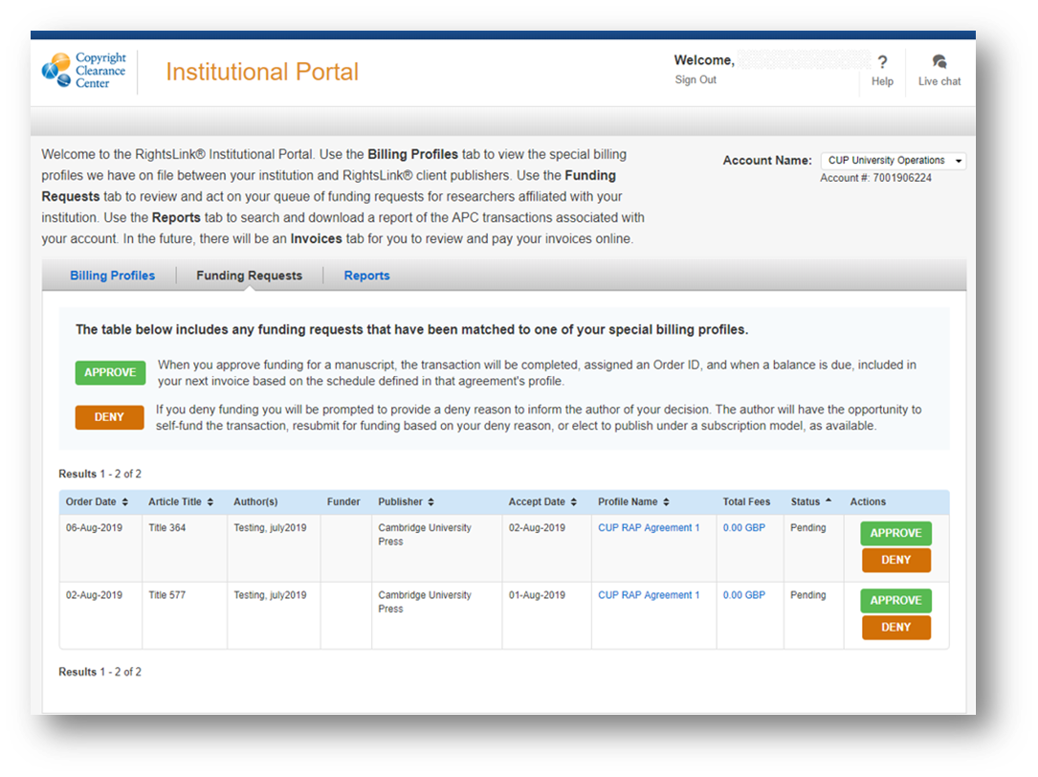
Turn on automatic approvals
Save yourself time: 'Notifications' feature

Slide 8
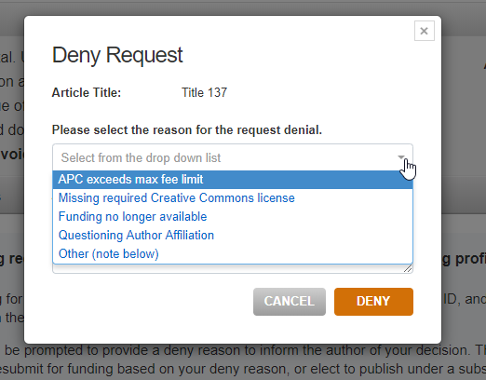
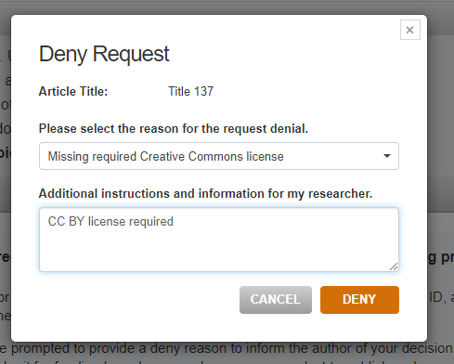
Denials
If denying, a reason for denial must be given. This information is sent to the author in a denial notification email.

Slide 9
Over to you, let’s complete and check the set up
1. Locate e-mail and log in
2. Ensure all contacts are added
3. Turn on auto approvals
4. Set notifications
5. Locate report button
6. Bookmark the page

Slide 10
2. Promote your agreement

Slide 11
Open Access Publishing Workflow
Prepare manuscript
Submit manuscript
Peer
review
Publication decision
APC
transaction
Article production
Article publication
All articles submitted to Cambridge University Press undergo the same rigorous peer-review to sustain the high quality of our journals.
The decision to publish an article is not affected by whether it will be published Open or behind a paywall.

Slide 12
Key author touchpoints
Upon submission: Authors are supported through the submission process and advised that eligibility is based on the affiliation information provided
Contracting stage: Authors are advised of their eligibility to publish OA under a deal (at no cost to them) at key decision points including contracting
Tailored messaging: Authors received messaging specific to them, the journal they are submitting to and the agreement they are covered by
Dedicated OA support: Our OA support team are on hand to support you and your academics OAqueries@cambridge.org

Slide 13
We've collated all of this information in our Librarian toolkit Available here

Slide 14
Promoting your agreement to researchers and faculty
Share the news: Use our template messaging suggestions and graphics for social media, web channels and newsletters
Raise awareness of the agreement: Link out to your dedicated agreement page covering all the important information in one place
Grow support for Open Access on campus: Our resources clearly outline the basics and benefits of OA.
Myth busting OA information: Share these resources with your and confidently answer OA-related questions

Slide 15
Where do I start?
1
2
3
Share the news on your established channels
Link out to your agreement page containing key information
Add links to key Cambridge resources to author guidance pages
Notes:
3 most important things you can do after this call...
We have templated copy at the ready (part of librarian toolkit) + resources and guides are also in the librarian toolkit
Whatever ways admins currently communicate with authors, we have resources to support that (e.g. social media, email, etc)
Suggest attendees include link to their respective Core page

Slide 16
3. Use your TA with confidence - Answers at the ready

Slide 17
Author FAQs
Am I still eligible to publish if I am a student/visitor/other?
Am I still eligible if I am no longer affiliated with my institution?
Which creative commons license can I use?
My library declined my funding request. What can I do?
Notes:
1. Am I still eligible to publish OA through a TA if I am a student/visitor/other?
As publisher, we do not make distinctions between different types of academic positions when assessing eligibility – it is broadly determined by the corresponding author’s affiliation printed on the manuscript. Final approval for the APC waiver however is left to the discretion of the author’s library, who may prefer to reserve their OA funding to certain members of faculty. If in doubt, please get in touch with them directly before opting into Gold OA publishing. Please see our affiliations policy for further information.
2. Am I still eligible if I am no longer affiliated with my institution?
Eligibility is based on the corresponding author's affiliation printed on the manuscript. As this typically reflects where the research was conducted, we still consider an author even if they have moved to another position after their manuscript is accepted. As above, however, final approval is nevertheless left to the discretion of the library. If in doubt, please get in touch with them directly before opting into Gold OA publishing. Please see our affiliations policy for further information.
3. Which Creative Commons Licenses can I publish my article using?
Most of our journals offer OA publication using either CC-BY, CC-BY-NC-SA or CC-BY-NC-ND. More detail regarding each license type can be found here. We leave the choice of license to the author’s discretion, however for funder compliance purposes some institutions may require their authors to choose CC-BY as a default. If in doubt, get in touch with your library for confirmation first.
4. I requested to publish OA through my institution’s agreement, but my library declined my funding. What do I do?
It depends on the scenario. If you would like to contest the decision, please be in touch with your library using the contact e-mail provided in the ‘Funding Decision Summary’ e-mail you will have received from Rightslink CCC (no-reply@email.copyright.com). If you are publishing in one of our hybrid journals, please be in touch with your regular Cambridge production contact requesting to publish your article non-OA instead. Our standard publishing license is offered free of charge. If you are publishing in one of our Gold OA or Research Open journals, click here to apply for a discretionary waiver.

Slide 18
How Cambridge will support your TA

Slide 19
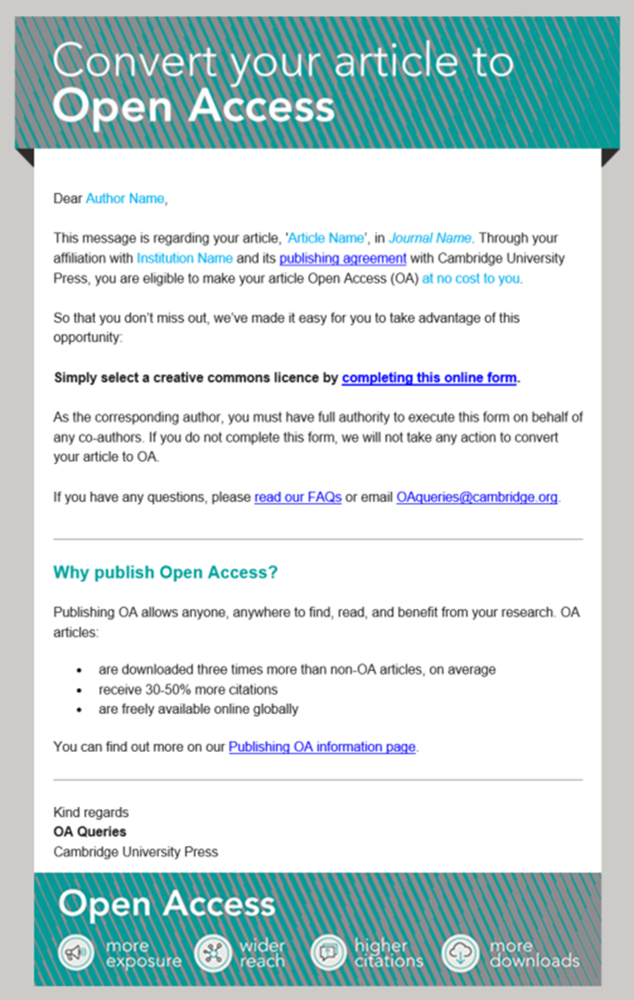
Retroactive OA
Cambridge contacts authors of articles that were eligible to publish under your TA but have not yet taken up the opportunity. Our communications, sent automatically to the corresponding authors e-mail address – provides a timely reminder of the no cost OA option available and how to take advantage of it. This author outreach is ongoing and will continue throughout the year.
74% response rate

Slide 20
Supporting your TA
Reporting We will support your institution throughout the term of a transformative agreement with quarterly publishing updates
Stay informed - Publishing activity with article-by-article information
Collated key information to support internal reporting including article DOI and license information
Notes:
New report format forthcoming

Slide 21
We're here to help
OA queries inbox
(oaqueries@cambridge.org)
Help and Training (multi-language resources)
https://www.cambridge.org/core/help/training

Slide 22
What we covered
1
2
3
TA Account Setup
Agreement Promotion and Resources
Author questions and support from Cambridge
Notes:
3 most important things you can do after this call...
We have templated copy at the ready (part of librarian toolkit) + resources and guides are also in the librarian toolkit
Whatever ways admins currently communicate with authors, we have resources to support that (e.g. social media, email, etc)
Suggest attendees include link to their respective Core page

Slide 23
Thank You!
Questions/Comments?

